Slide 1


ASANSOL ENGINEERING COLLEGE
Topic: TechTube - An E-Learning Platform
Presented By:
Roumodip Das(10800220004)
Sneha Sarkar(10800220057)
Kunal Kesh(10800220025)
Abhishek Choudhary(10800220030)
Under the Guidance of
Mr. Biplab Kumar Mondal
Asst. Professor
Dept. Of Information Technology

Slide 2
CONTENT
Introduction
Languages Used
DFD Of the project
User Interfaces
Conclusion & Future Scope

Slide 3
INTRODUCTION
This project illuminates the myriad advantages that this innovative learning platform brings to the forefront. From flexible accessibility and personalized learning paths to interactive content and global connectivity, explore how TechTube redefines the landscape of education for the better. This report embarks on an exploration of the manifold advantages inherent in this cutting-edge platform. One of the standout features of TechTube is its commitment to flexibility. Learners can access a wealth of educational content at their convenience, breaking free from traditional constraints of time and location. This flexibility not only accommodates diverse schedules but also fosters a learner-centric environment. Interactivity becomes a cornerstone of education with TechTube. Dynamic multimedia content, and collaborative tools such as students can ask doubts directly creates an immersive learning environment. This not only keeps learners actively engaged but also promotes a deeper understanding of the subject matter through hands-on experiences. Breaking down geographical barriers, the platform connects learners and educators from around the world, fostering a rich exchange of ideas and perspectives. This interconnectedness broadens the educational experience, offering a global perspective on various subjects. As we navigate through the depths of this report, we will uncover how TechTube's forward-thinking design and features contribute to an enriched and effective e-learning journey

Slide 4




LANGUAGES USED
HTML is used for Frontend User Interface in this project.
CSS is used for styling the components in this project using external and inline CSS.
JavaScript is used for DOM manipulation and other interactions in this project.
PHP is used for Backend
Development in this project.

Slide 5
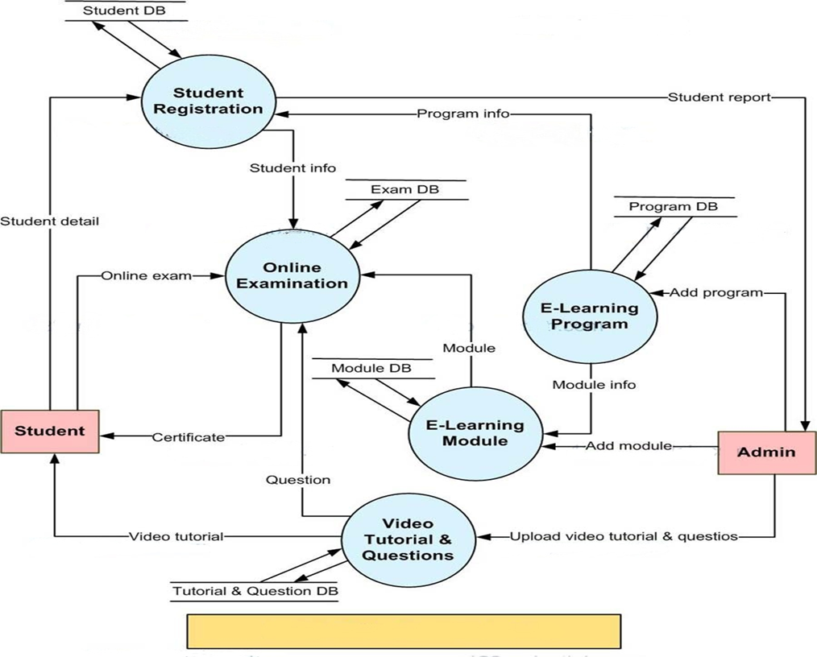
DFD OF THE PROJECT

Slide 6

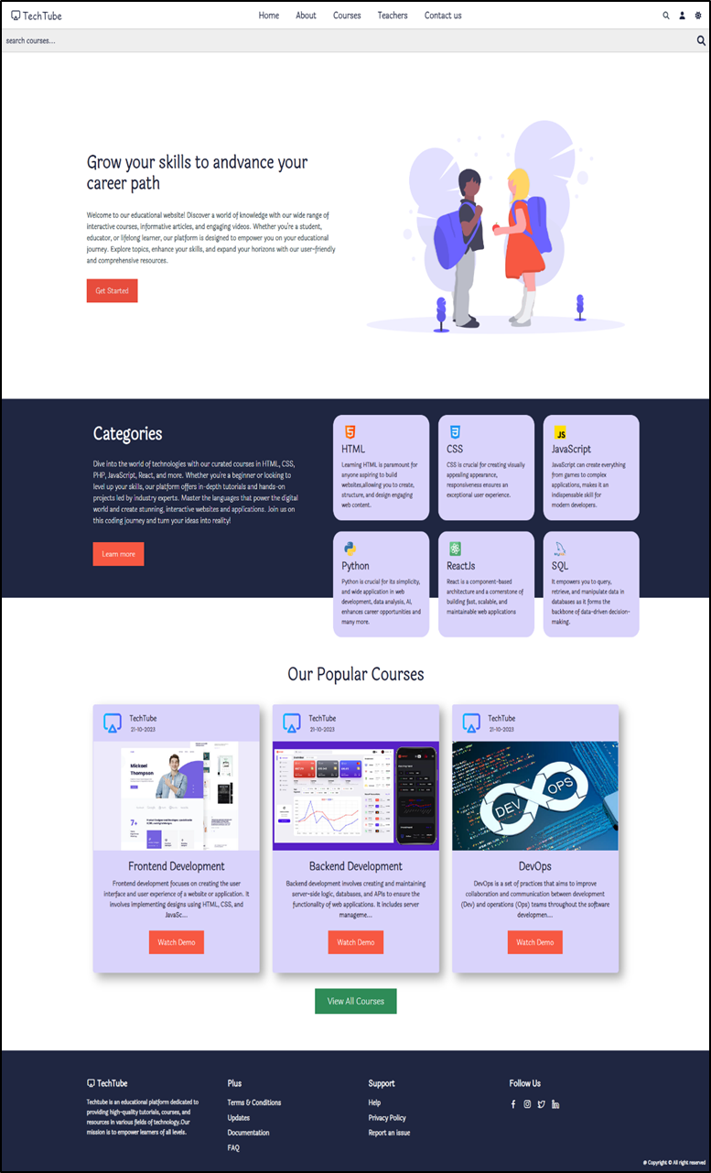








HOME PAGE
Nav Bar
Search Bar
Header Section
Redirects to the login page.
Categories Section
Redirects to the
about page.
Courses Section
Redirects to the courses page.
6
Footer Section

Slide 7
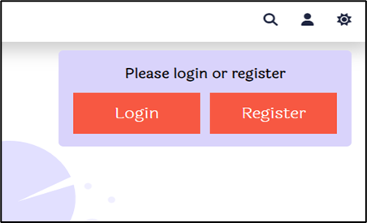

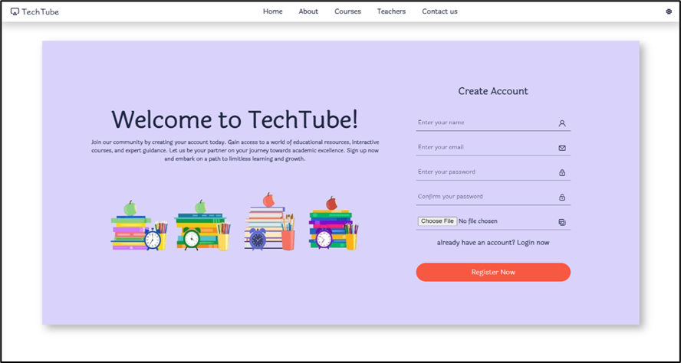
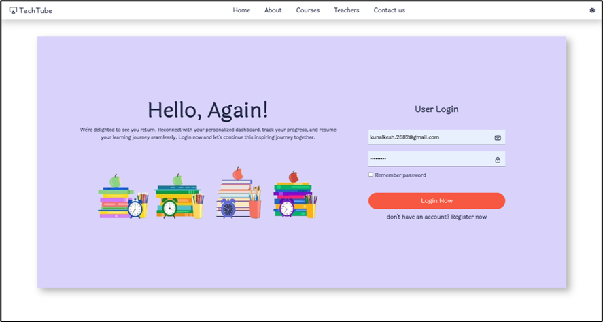
LOGIN / REGISTER PAGE
Redirects to login or register page accordingly.
7

Slide 8
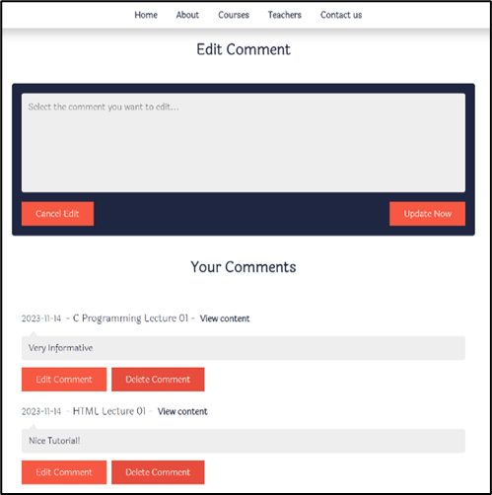
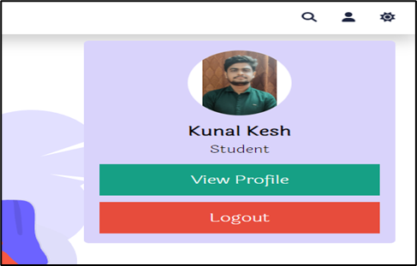
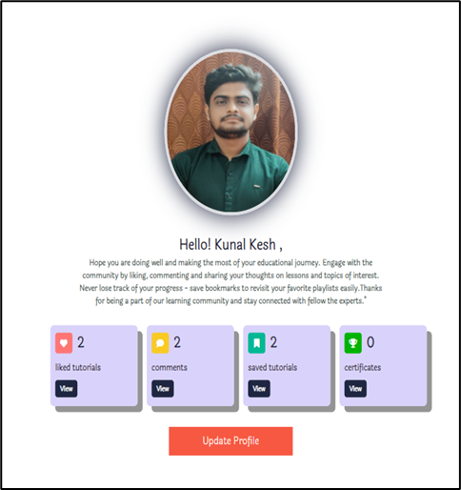

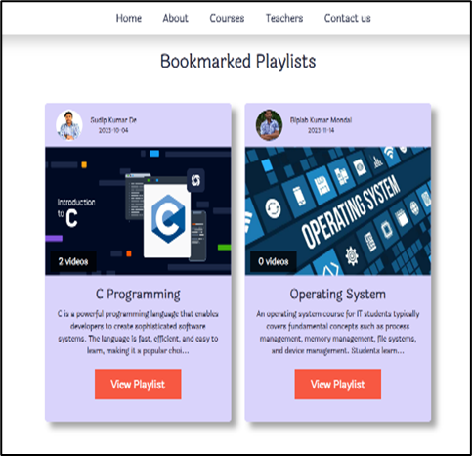
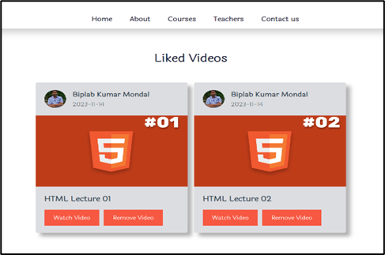
PROFILE PAGE
Redirects to the Profile Page, to view profile picture liked, commented & saved tutorials.
8

Slide 9

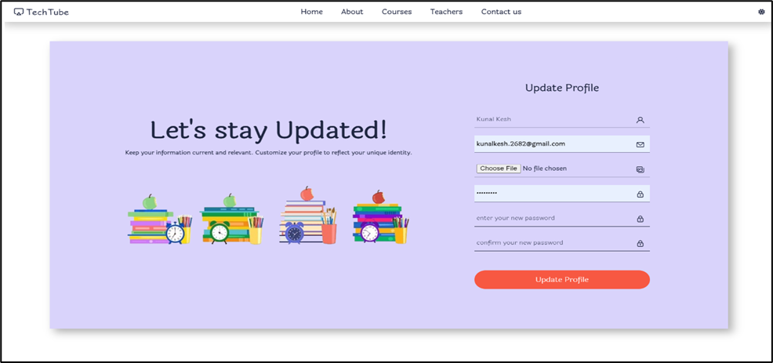
UPDATE PROFILE
9

Slide 10
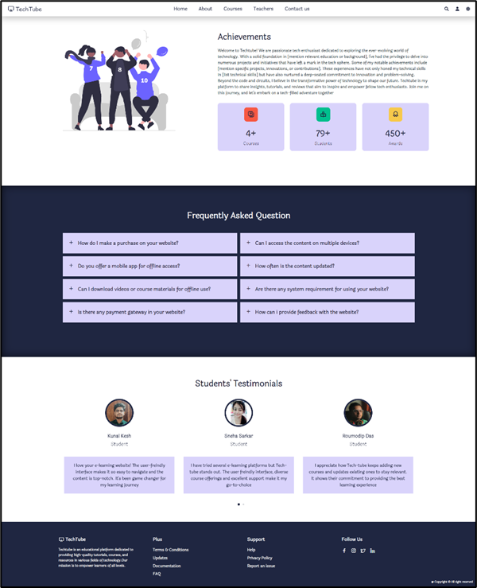

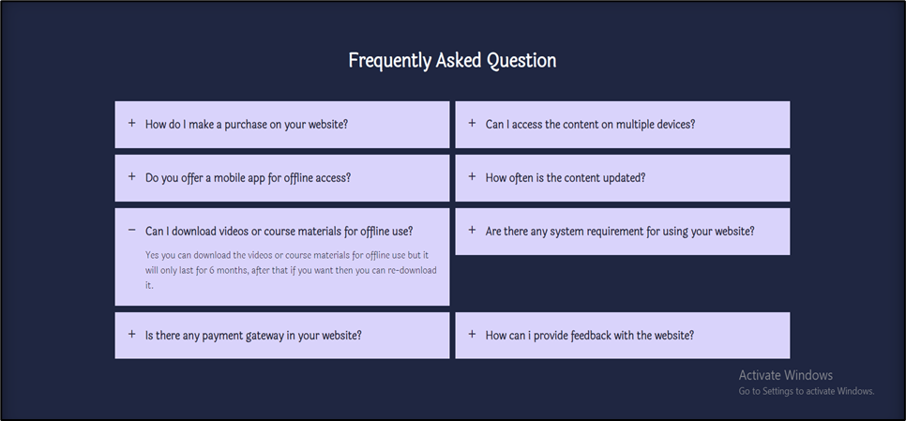
ABOUT PAGE
Achievement Section
FAQs Section​
Testimonials Section​
10

Slide 11
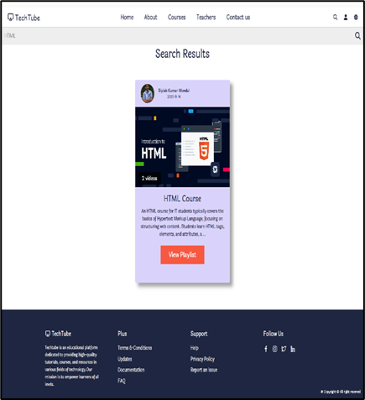
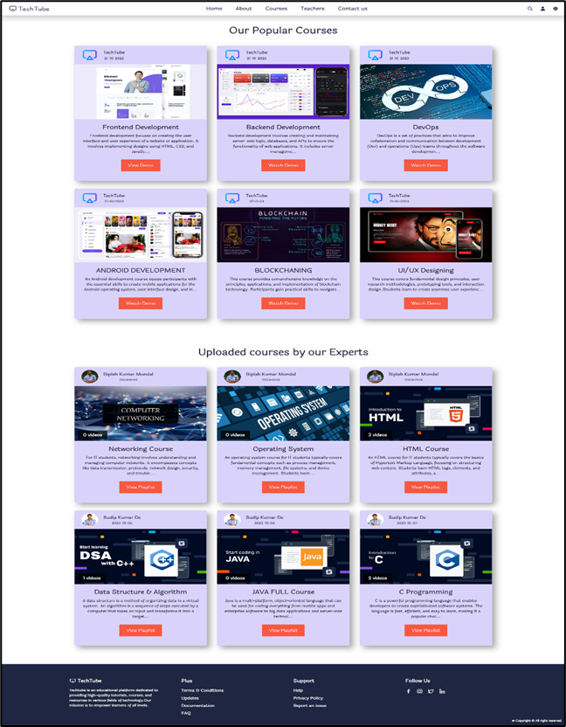

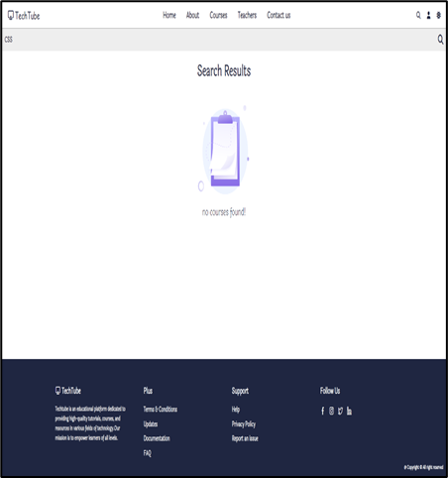
COURSES PAGE
Demo video Section
Uploaded Course Section
11

Slide 12
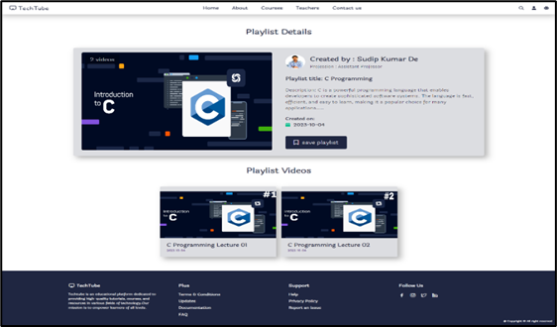
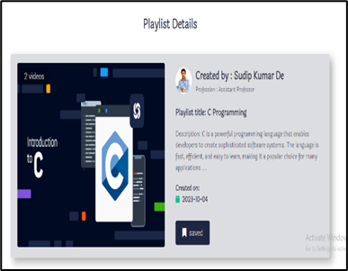


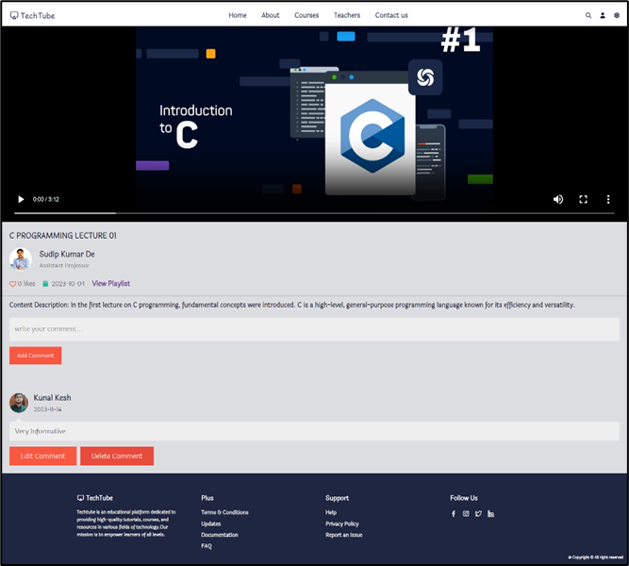
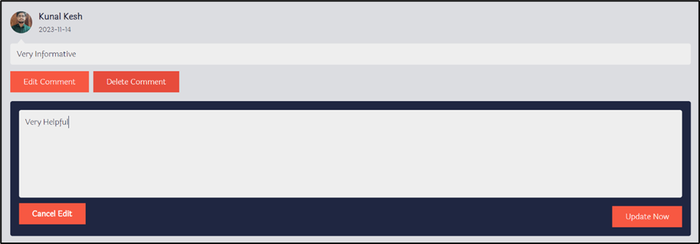



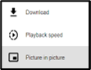

PLAYLIST/WATCH VIDEO PAGE
Likes Count
Video Control
Comment Section
Edit Comments
12

Slide 13
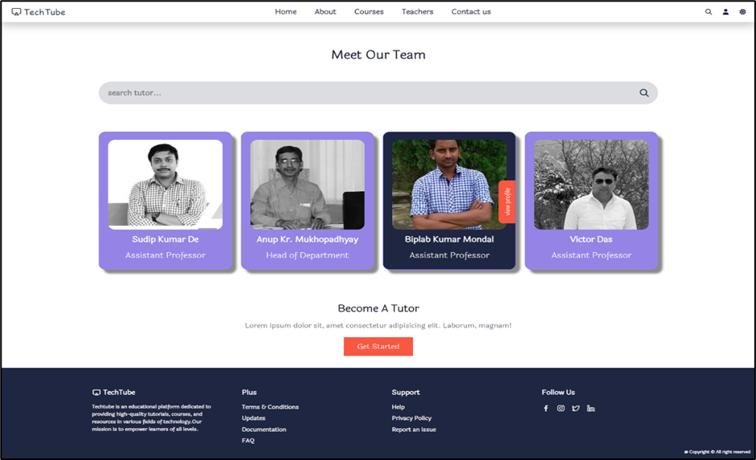
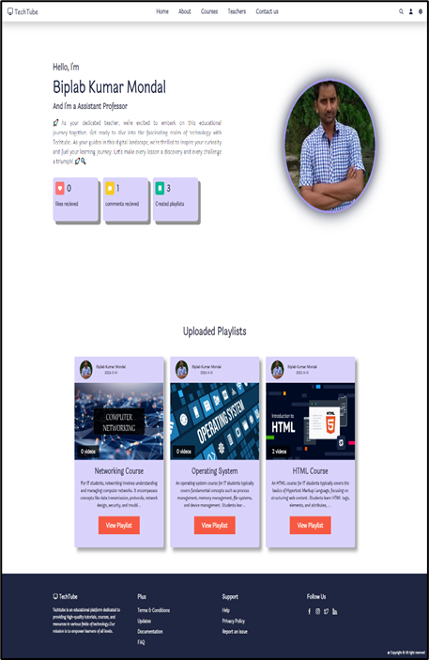


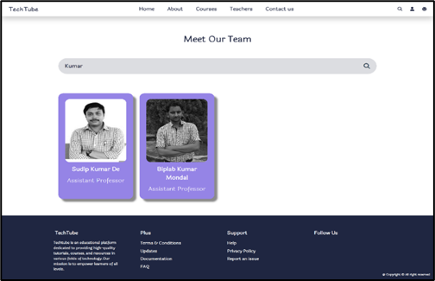
TEACHERS PAGE
Redirects to the teacher’s profile page

Slide 14
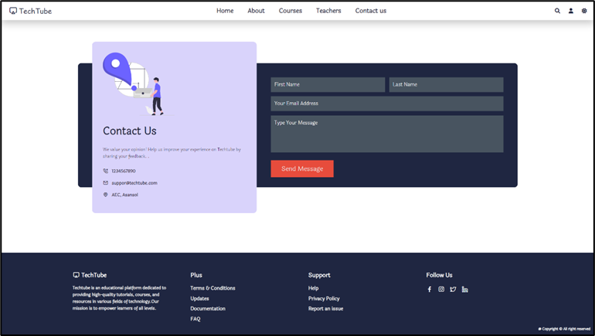


CONTACT PAGE
Send Queries

Slide 15
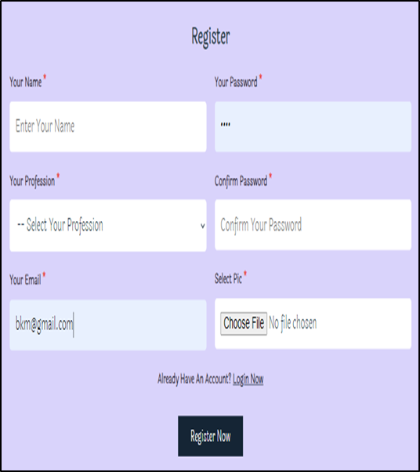
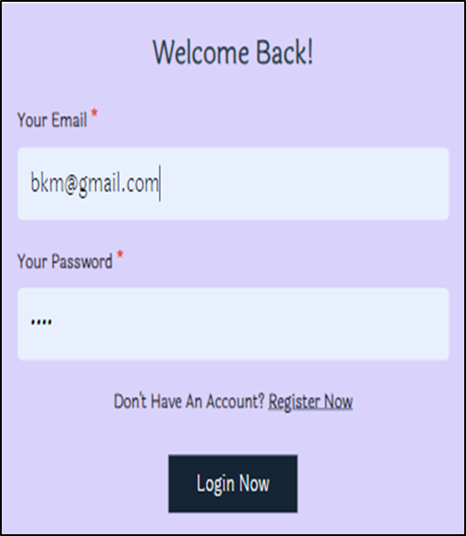
ADMIN PORTAL OVERVIEW
If you are a new user. Register your account
Otherwise Login

Slide 16
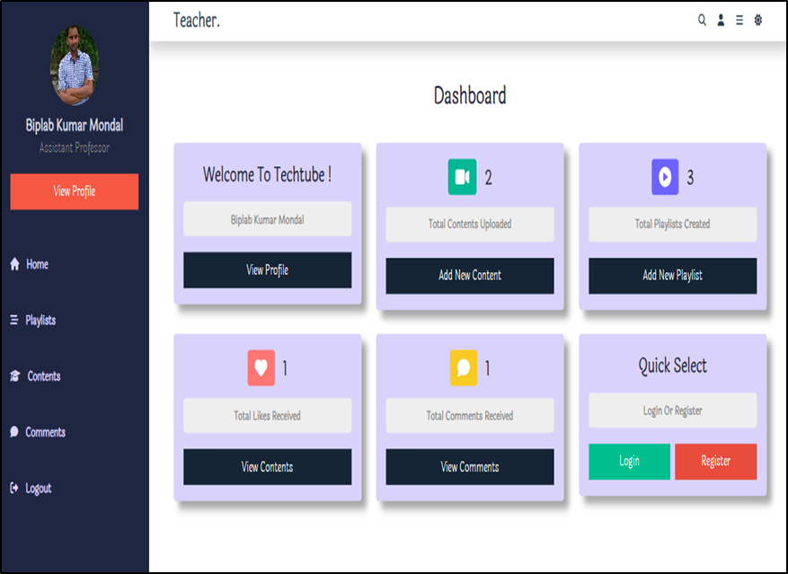
DASHBOARD
View uploaded
contents
View added playlists
Teacher 's profile
View Teacher 's profile
Liked videos
Comments Received
Redirects to login/register page

Slide 17
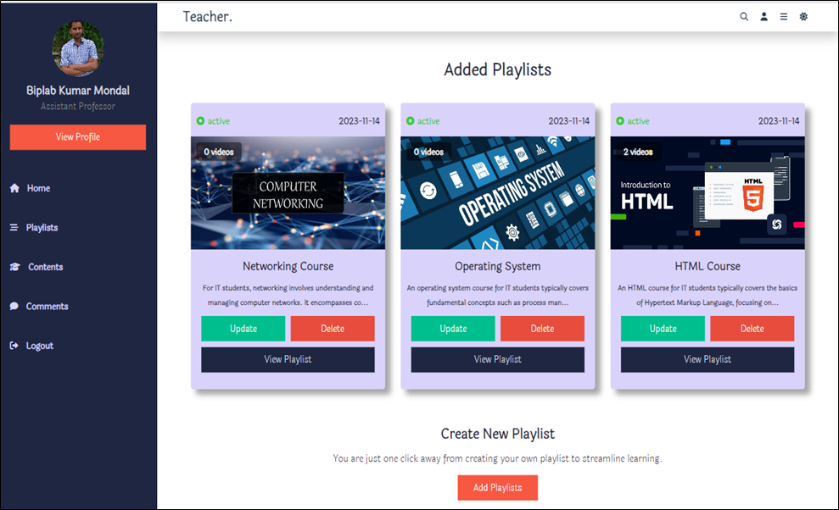
PLAYLIST PAGE
Delete content
Redirects to view playlist page, where you can bookmark a playlist and view the uploaded contents
Redirects to uipdate form page
Add new playlist. Redirects to add playlist form.

Slide 18
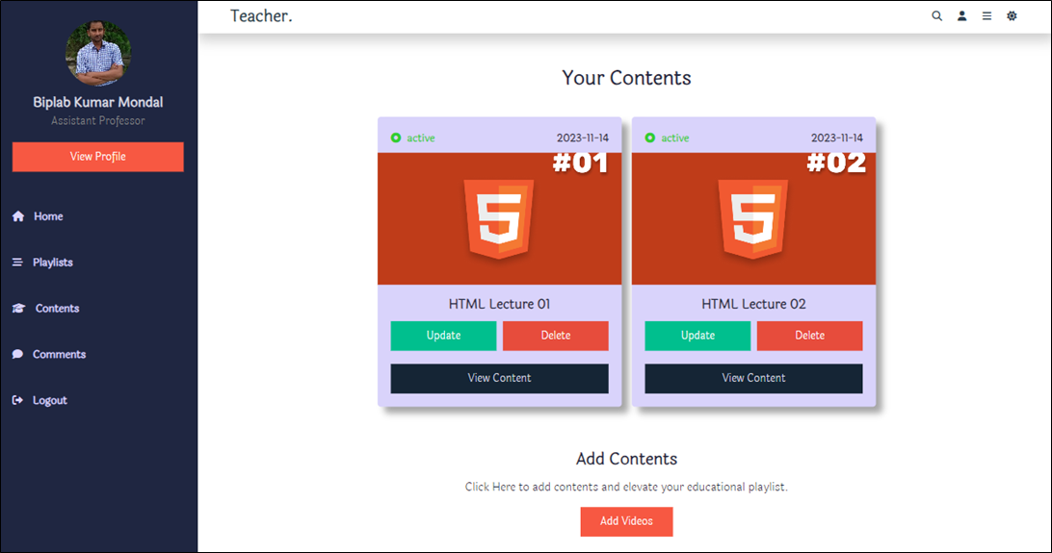
CONTENTS PAGE
Delete Content
Watch the uploaded video
Add new contents. Redirects to add contents form.
Update existing playlist. Redirects to update content form.

Slide 19
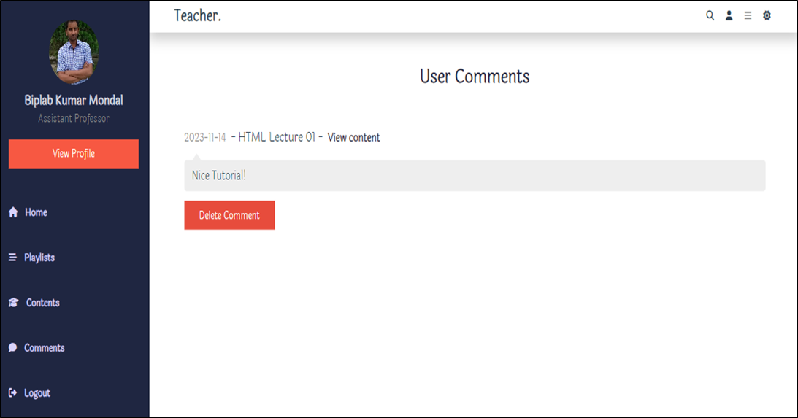
COMMENTS
Comment received

Slide 20

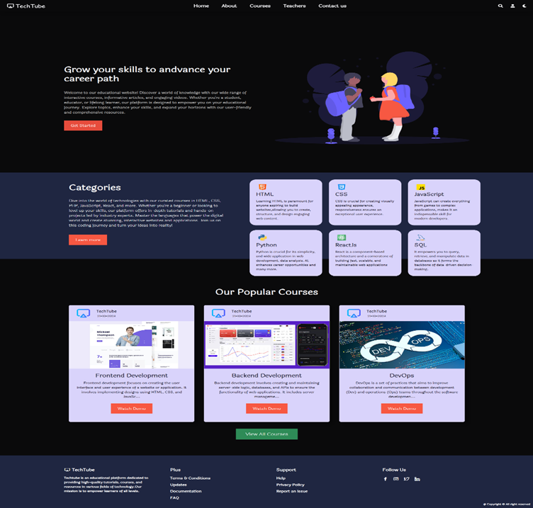

DARK MODE
Dark Mode Enabled

Slide 21
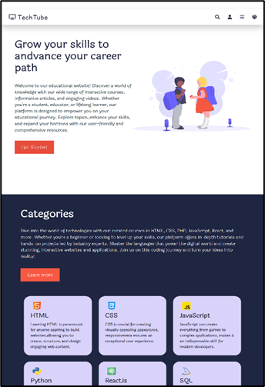
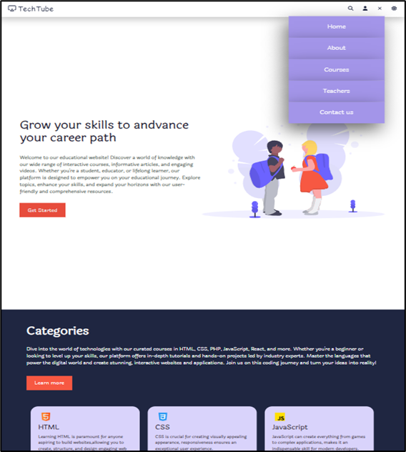





RESPONSIVENESS(TAB AND MOBILE VIEW)
Hamburger Menu
Nav Menu in Tablet View
Mobile View
IPhone SE (375 x 667)
Tablet View
IPad Pro (1024 x 1366)

Slide 22
CONCLUSION
In conclusion, Techtube serves as a commendable educational website, providing a wealth of learning opportunities for users. Through its diverse array of content, ranging from tutorials and lectures to practical demonstrations, Techtube caters to a broad audience with varied learning preferences. The platform's user-friendly interface enhances the overall learning experience, allowing for seamless navigation and accessibility.
Moreover, Techtube's commitment to quality education is evident in the meticulous carnation of its content, ensuring relevance and accuracy. The inclusion of interactive features and community engagement further fosters a dynamic learning environment, encouraging collaboration and knowledge-sharing among users. As a valuable resource, Techtube not only imparts knowledge but also inspires a spirit of curiosity and continuous learning. Whether one is a novice or an expert in a particular field, Techtube stands as a reliable companion on the journey of educational exploration, making it a noteworthy platform in the realm of online education.

Slide 23
FUTURE SCOPE
The future scope of TechTube, with its innovative certificate system, is expansive and promising. By integrating automatic certificate generation contingent on successful course completion, we are poised to revolutionize online learning. This feature not only incentivizes students to genuinely engage with the course material but also ensures the credibility and value of the certification.
One key future development is the enhancement of our pop-up question mechanism. By refining the timing and difficulty of the pop-up questions, we can ensure that each student remains actively engaged and appropriately challenged. This will enhance the overall learning experience by preventing passive consumption of the content and promoting active participation.
Moreover, the integration of advanced analytics will allow instructors to gain deeper insights into student performance and engagement patterns. This can inform continuous improvement of course content and instructional strategies, leading to more effective learning outcomes.

Slide 24
REFERENCE
https://flatuicolors.com/palette/defo
https://www.flaticon.com/
https://www.youtube.com
https://www.pngegg.com/
https://fonts.google.com/
https://storyset.com/
https://cdnjs.com/libraries/font-awesome
https://swiperjs.com/
https://unicons.iconscout.com/release/v2.1.6/css/unicons.css
https://formspree.io/

Slide 25
Thank You !

